Slide 1
Waterways Events
Captain Jim Suber
Waterways Coordinator

Slide 2
DERELICT VESSEL REMOVAL
INTERCOASTAL WATERWAY
FWCC CASE
$6000.00
FWCC GRANT

Slide 4
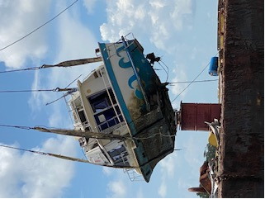

Slide 5
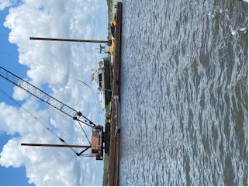

Slide 6
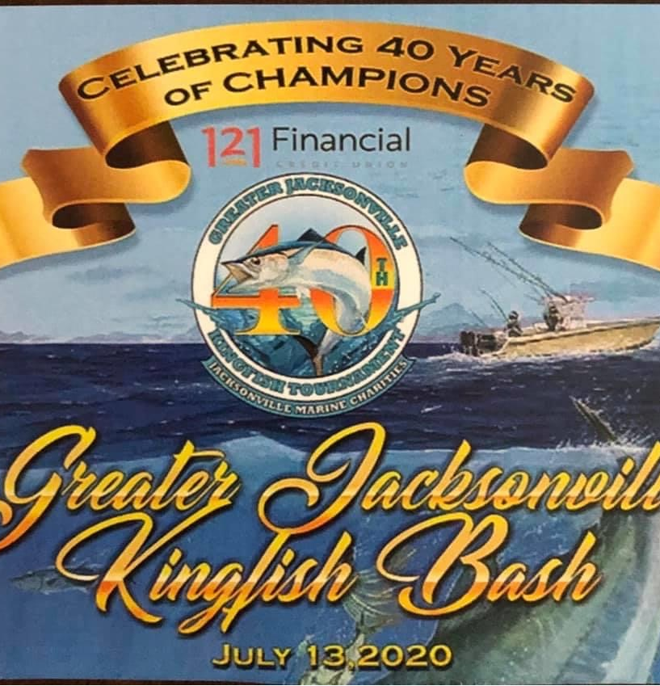

Slide 7
8 TOURNAMENTS IN ONE WEEK
MEDIA AND SPONSOR DAY
KINGFISH BASH
PAST CHAMPIONS TOURNAMENT – 40 ANGLERS
HIGH ROLLER – 30 ANGLERS
JR. ANGLER TOURNAMENT
TWO DAY GENERAL TOURNAMENT
RED SNAPPER TWT
LADY ANGLER TOURNAMENT
REDFISH TOURNAMENT
OVER $300,000.00 IN PRIZES AND AWARDS

Slide 8
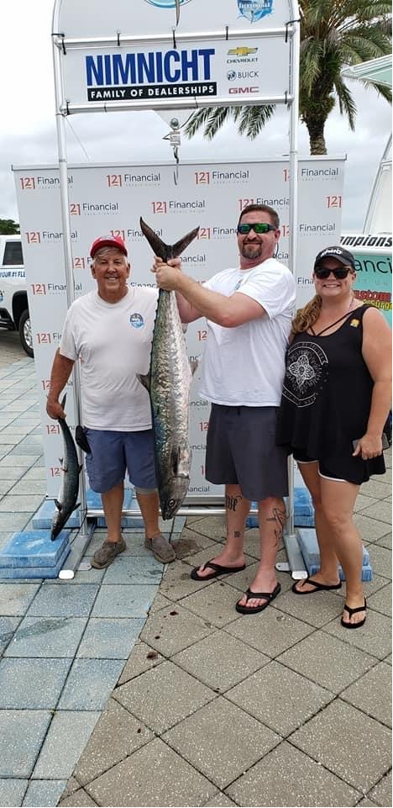
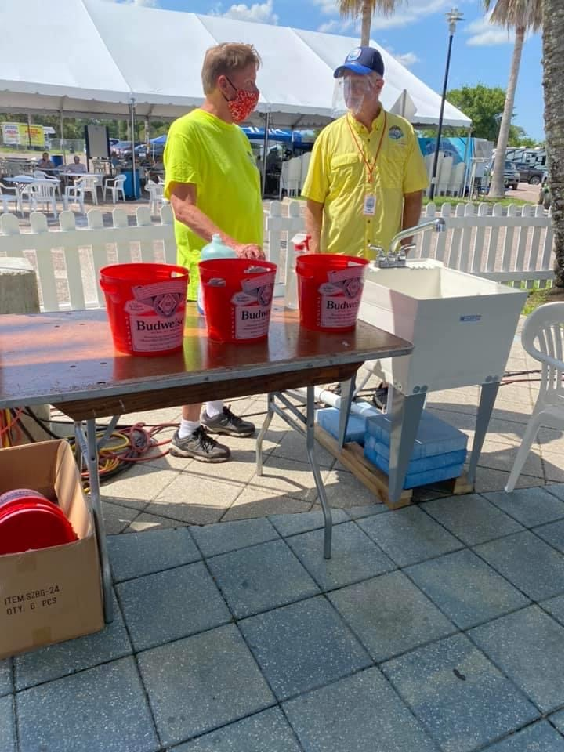

Slide 9
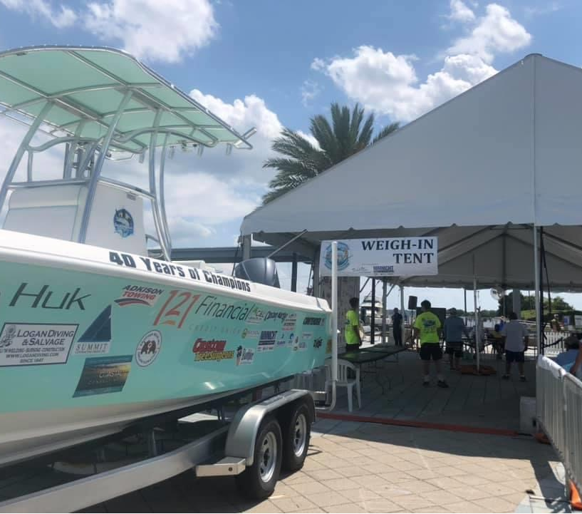

Slide 10
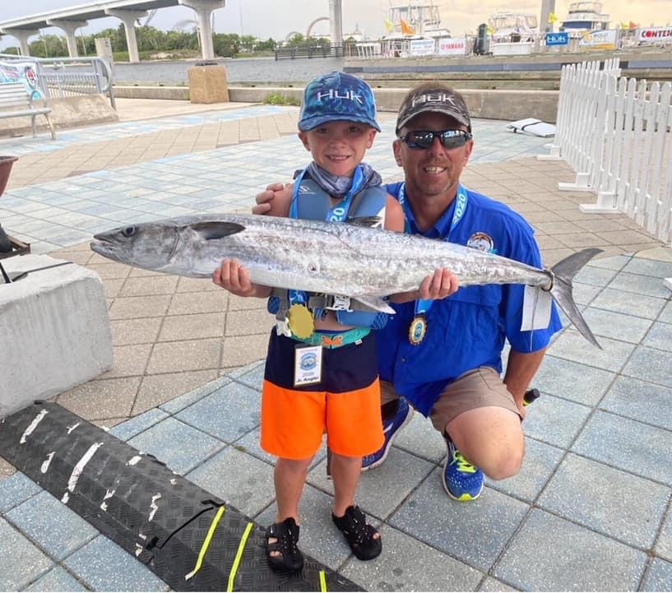

Slide 11
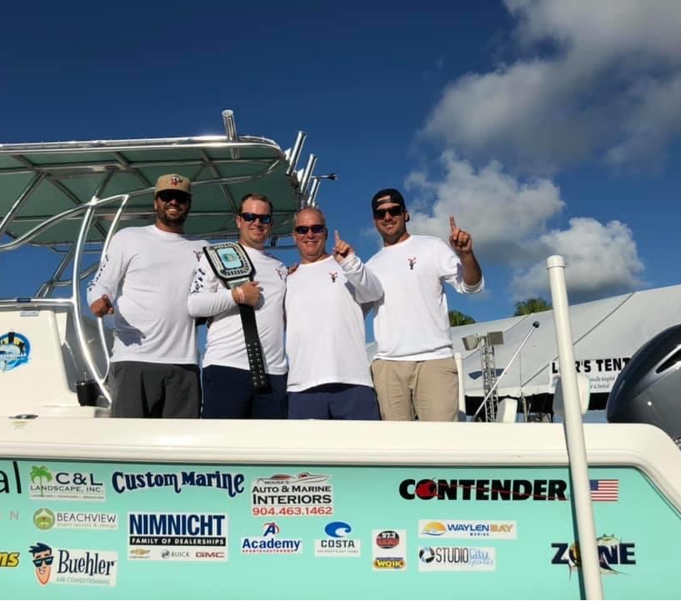

Slide 12
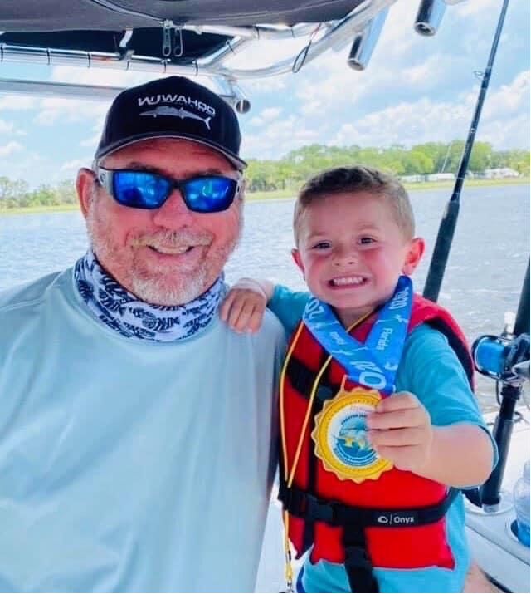

Slide 13
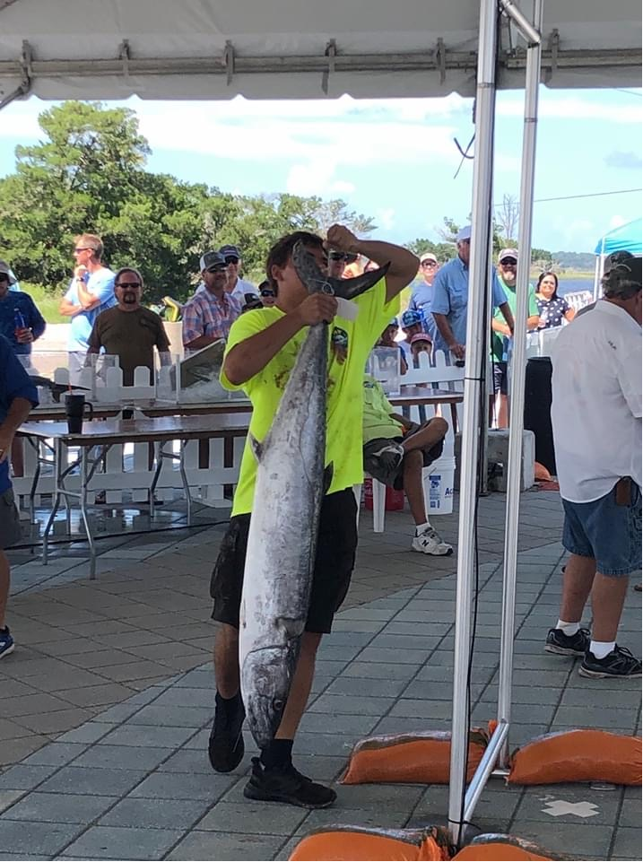

Slide 14
BOAT RAMP VIDEO CAMERAS
USBoatramps.com
Android or Apple apps.

Slide 15
PALMS FISH CAMP

Slide 16
JIM KING PARK AND BOAT RAMP

Slide 17
MAYPORT BOAT RAMP

